Slide 1
Eye Tracking Drift Correction Algorithm
AMK 08/24/16

Slide 2
Overview
Defining Fixations in Raw Data
Dispersion-based algorithm
Results depend on parameters used to define fixation
Implementation
Drift Correction
Least-squares optimization of average distance from each fixation to nearest stimulus
Multiplicative vs additive versions

Slide 3
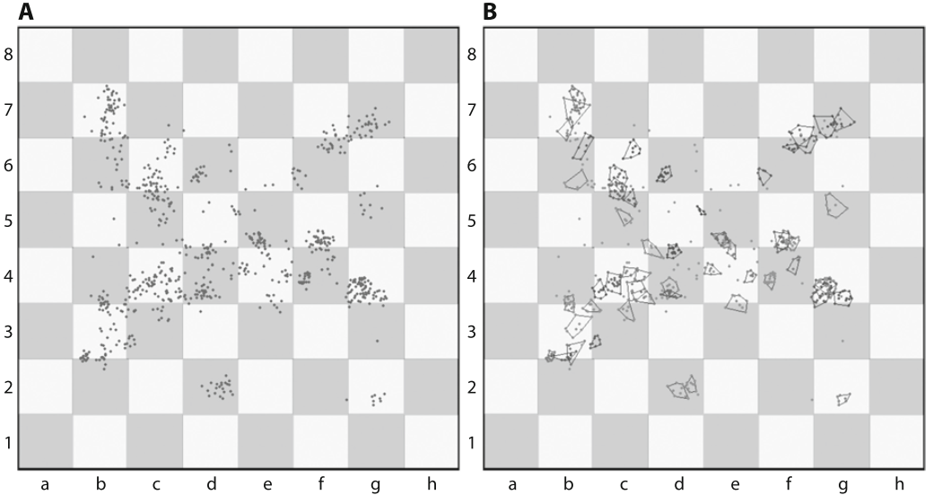
Defining Fixations in Raw Data
Raw points of regard (PORs) in A are grouped into fixations in B based on two parameters: minimum fixation duration & maximum dispersion radius

Slide 4
Dispersion-Based Fixation Algorithm & Parameters
Minimum Duration: (in milliseconds) the minimum duration of a fixation; Manor and Gordon (2003, as cited in Blignaut, 2009, p. 884) recommend values of 100 - 200 ms
Maximum Dispersion: the maximum dispersion within a fixation; Blignaut (2009, p. 894) recommends values of .7 - 1.3 degrees visual angle as optimal
where dispersion = max( sqrt( (x_{i} – x_{M}).² + (y_{i} – y_{M}).² ) ) for a set of continuous PORs
Any set of continuous PORs meeting these criteria are counted as a fixation in this dispersion based algorithm.

Slide 5
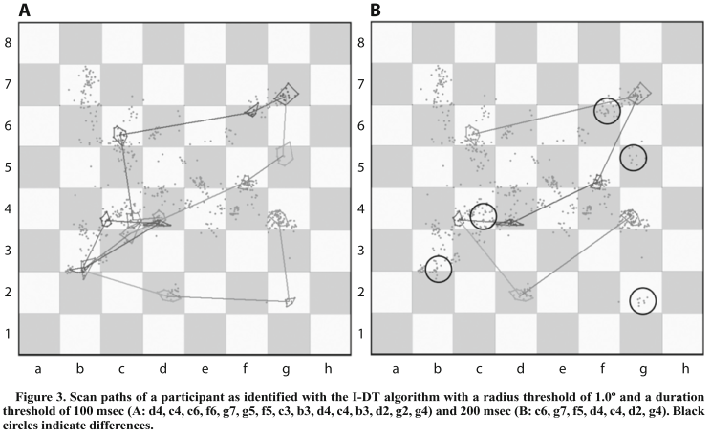
Results Depend on Parameters

Slide 6
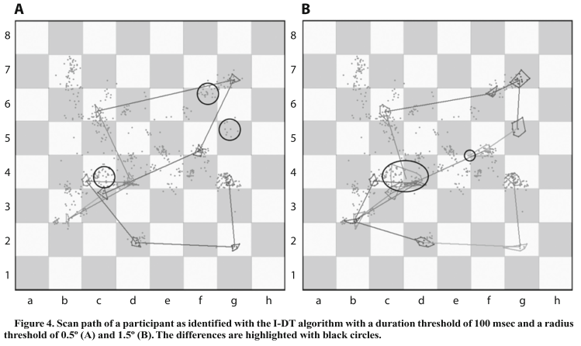
Results Depend on Parameters

Slide 7
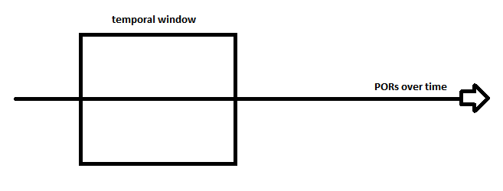
Implementation
calculate dispersion
Initializes temporal window of minimum fixation duration
If dispersion < threshold
Adds time points of raw data to window until dispersion > threshold
Documents fixation indices in time, coordinates and dispersion
Elseif dispersion > threshold
Advances the beginning of temporal window by one time point and starts over
Blinks and end of data array are treated as dispersions > threshold

Slide 8
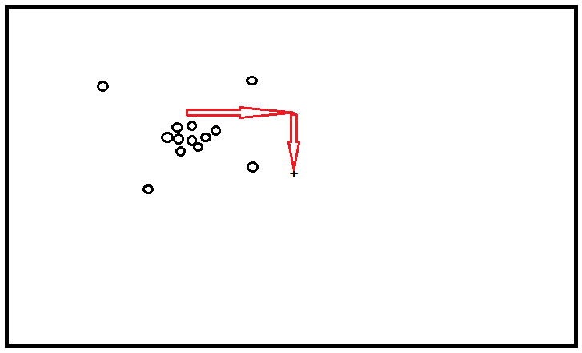
Drift Correction
Input: the coordinates of a set of fixations; and the coordinates of a set of stimuli on which subjects are most likely to fixate
Uses optimization to find the additive x and y transformations that minimize the average distance from each fixation to the nearest stimulus
Applies this optimal linear transformation to all data within each block

Slide 9
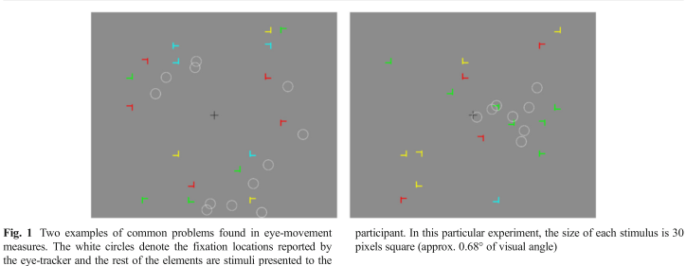
Multiplicative vs Additive Versions
The algorithm outlined on the previous slide is based on Vadillo et al. (2015) who use a multiplicative transformation: drift corrected fixation coordinates = T * raw fixation coordinates
Where T is an optimized transformation matrix: [x_{coefficient} 0; 0 y_{coefficient}]
The multiplicative form of the algorithm rescales the variance of the raw data to better fit the likely coordinates of fixation. This is similar to the way the eye tracker calibrates and is ideal in some circumstances (see right figure panel).

Slide 10
Multiplicative vs Additive Versions
For our purposes, the multiplicative algorithm over-fits the data such that all data points are pulled in toward the origin.
Potential solutions to this problem:
Additive version of algorithm
Give the multiplicative algorithm the coordinates of the edges of stimuli as other possible fixation locations.
Place a lower boundary on the x and y coefficients in the transformation matrix

Slide 11
References
Blignaut, P. (2009). Fixation identification: The optimum threshold for a dispersion algorithm. Attention, Perception, {&} Psychophysics, 71(4), 881–895. http://doi.org/10.3758/APP.71.4.881
Vadillo, M. A., Street, C. N. H., Beesley, T., & Shanks, D. R. (2015). A simple algorithm for the offline recalibration of eye-tracking data through best-fitting linear transformation. Behavior Research Methods, 47(4), 1365–1376. http://doi.org/10.3758/s13428-014-0544-1

